Slide 1

人臉辨識追蹤

Slide 2
Content
Object detecting
Subway surfer
Object tracking
Pygame module
視訊分析
互動技術
Dlib module
Game UI and notice

Slide 3
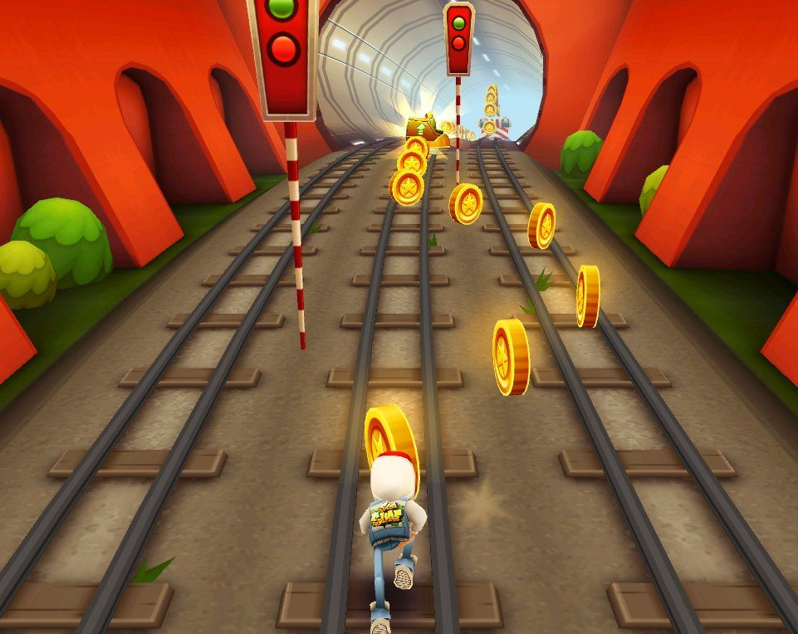
Subway surfer

Slide 4
Object detecting

Slide 5
Drawbacks
Detecting might be slower and inefficient
If the detected person is turning head slightly, the Haar cascade might not detect the face anymore
Unsteady

Slide 6
Object tracking

Slide 7
What is object tracking?

Slide 8
Viewpoint
視角
Occlusions
遮蔽
一個好的電腦視覺系統，應該能夠識別出戴口罩的臉，或被暫時遮蔽的頭像。
相同的物體從不同的角度觀看，會有不同的形狀或外形。
Illumination
Background
環境中不同的明亮度，對於電腦進行物體識別時會有很大的影響。
照明
背景
如何讓電腦正確識別主要物件而非旁邊類似物體。

Slide 9
Detecting vs Tracking
Tracking is faster than Detection
Tracking can help when detection fails

Slide 10
How to make it happen?

Slide 11
Dlib module

Slide 12
Dlib is a modern C++ toolkit containing machine learning algorithms and tools for creating complex software in C++ to solve real world problems.
Image Processing
Networking
Numerical Algorithms
Machine Learning
Threading
Graphical UI
Dlib

Slide 13
Using dlib.correlation_tracker() to create a tracker

Slide 14
Pseudocode
If tracker is not tracking:
• • • • create one and get the max area
else (tracker is on):
• • • • update the tracker
• • • • If the quality of update is good:
• • • • • • • • output the tracker position

Slide 15
Pygame module

Slide 16
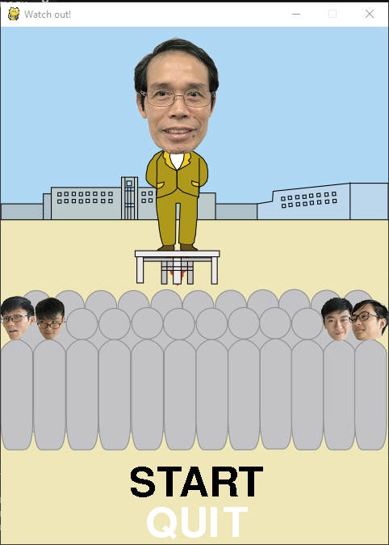
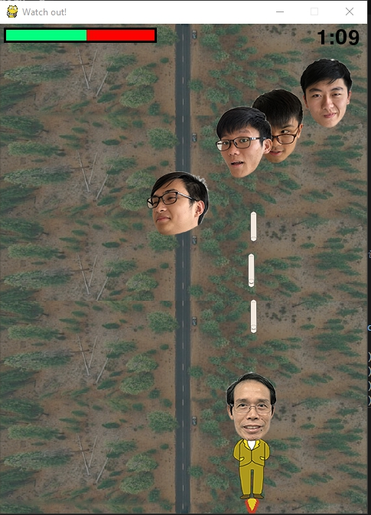
Game UI and notice

Slide 17
Let’s play

